Slide 1

I.C.O.N Greece

Slide 2
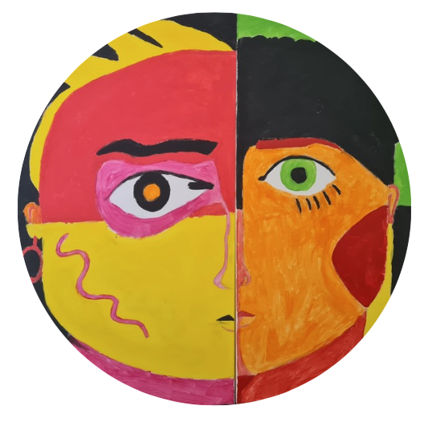
Raising Education to Strengthen People's Equality & Cultural R.E.S.P.E.C.T.
2022-1-ES01-KA210-SCH-000081000
Los Bolones, Spain
24.09.2024
Xanthi Albanaki
Michail – Angelos Chatziefthymiou

Slide 3

Results of R.E.S.P.E.C.T. project
Creation of a powerpoint about each partner school where students will present the bullying situation in their school, town, region, country;
Creation of an E-twinning platform;
Creation of the project's web page;
The organisation of a poster exhibition where the students prepare posters on the R.E.S:P.E.C.T.' topic;
Realization of a Guide on R.E.S:P.E.C.T.' topic.

Slide 4
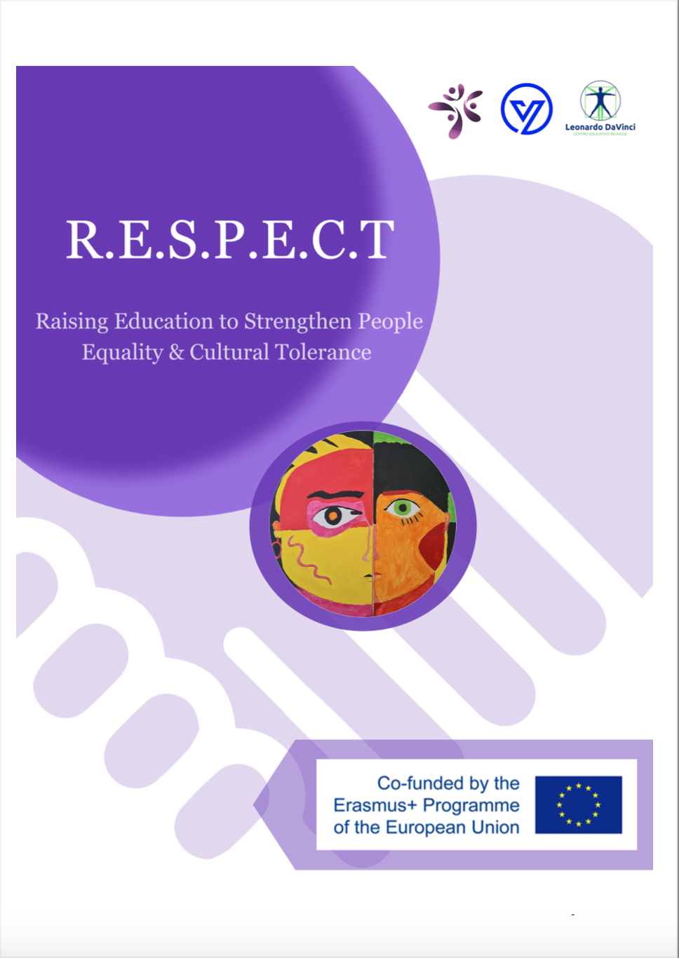


ICON’s task:
Realization of a Guide on R.E.S:P.E.C.T.' topic

Slide 5
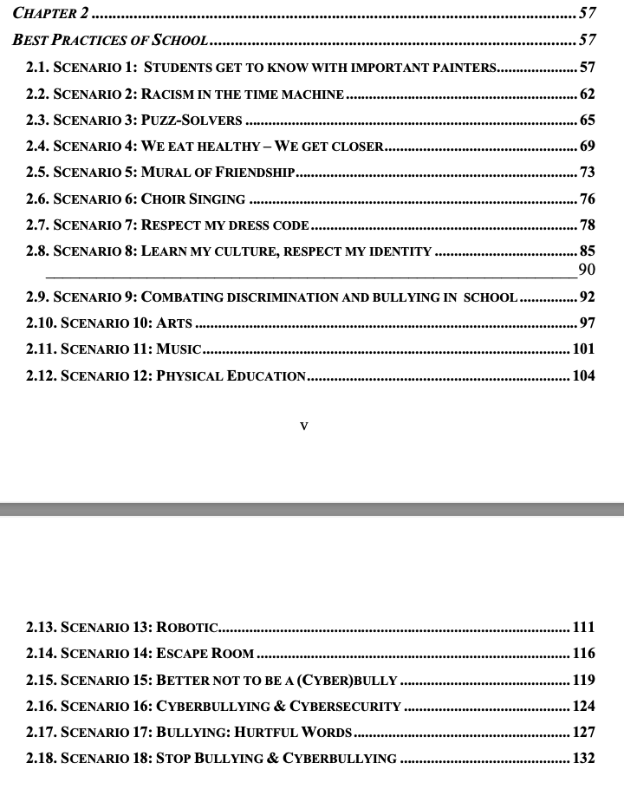
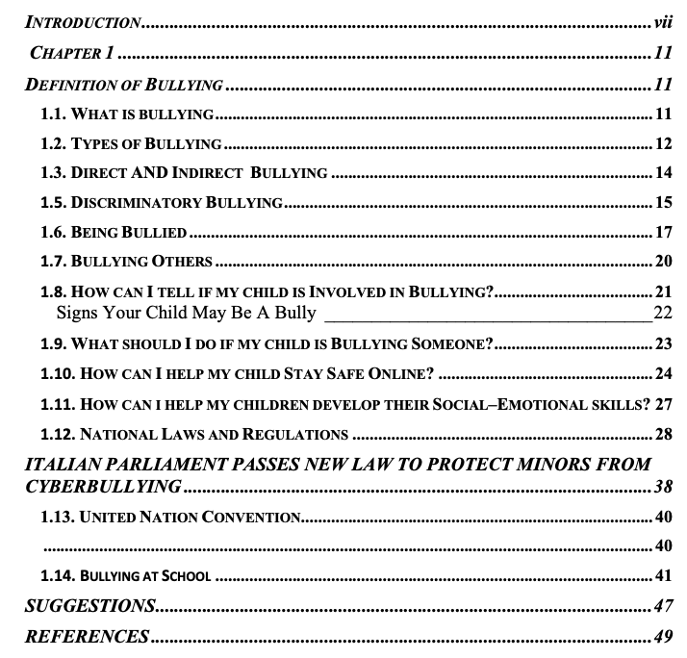
Table of Context

Slide 6
Chapter 1
Starts with defining bullying and covers a variety of topics related to it:
Definition and Types of Bullying: Explains what bullying is and the different forms it can take.
Direct and Indirect Bullying: Differentiates between bullying that is done face-to-face versus indirectly.
Discriminatory Bullying: Focuses on bullying related to discrimination.
Being Bullied: Discusses the experience of being bullied.
Bullying Others: Focuses on the perspective of the bully.
Signs Your Child May Be A Bully: Tips for identifying if your child is bullying others.
What to Do If Your Child is Bullying: Guidance for parents whose child is a bully.
Online Safety: Tips for keeping children safe online, potentially focusing on cyberbullying.
Developing Social–Emotional Skills: How to help children develop skills to avoid bullying and handle conflict.

Slide 7

Chapter 1
National Laws and Regulations: Overview of laws that relate to bullying, likely in various countries.
Italian Cyberbullying Law: Details about Italy's legislative measures to combat cyberbullying.
United Nations Convention: Likely refers to international protections and regulations related to bullying.
Bullying at School: Focus on bullying in educational settings.
Suggestions: Recommendations for addressing or preventing bullying.

Slide 8
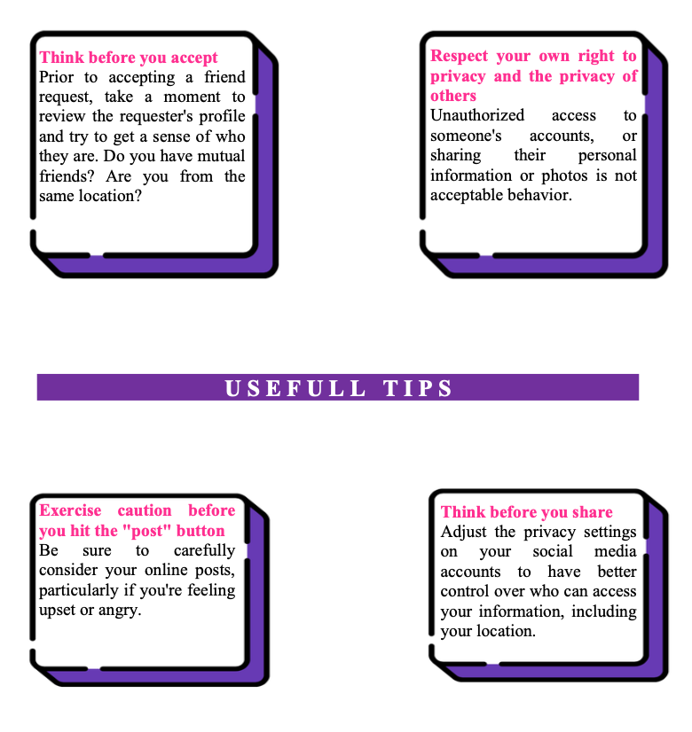
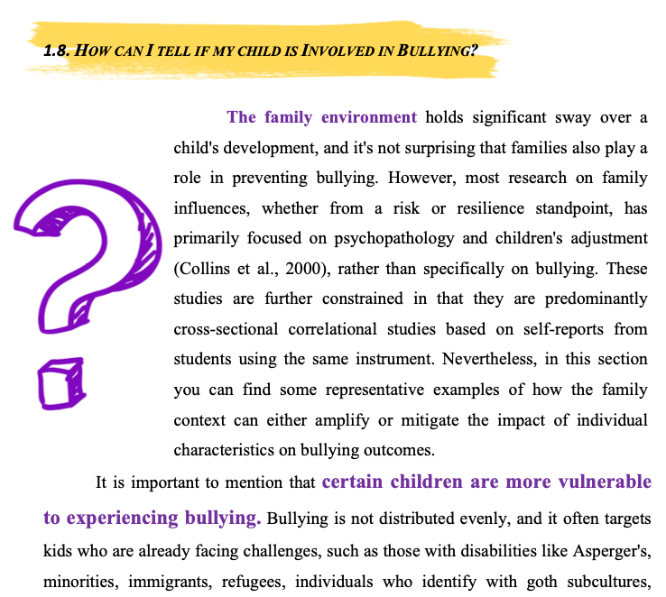
Chapter 1

Slide 9
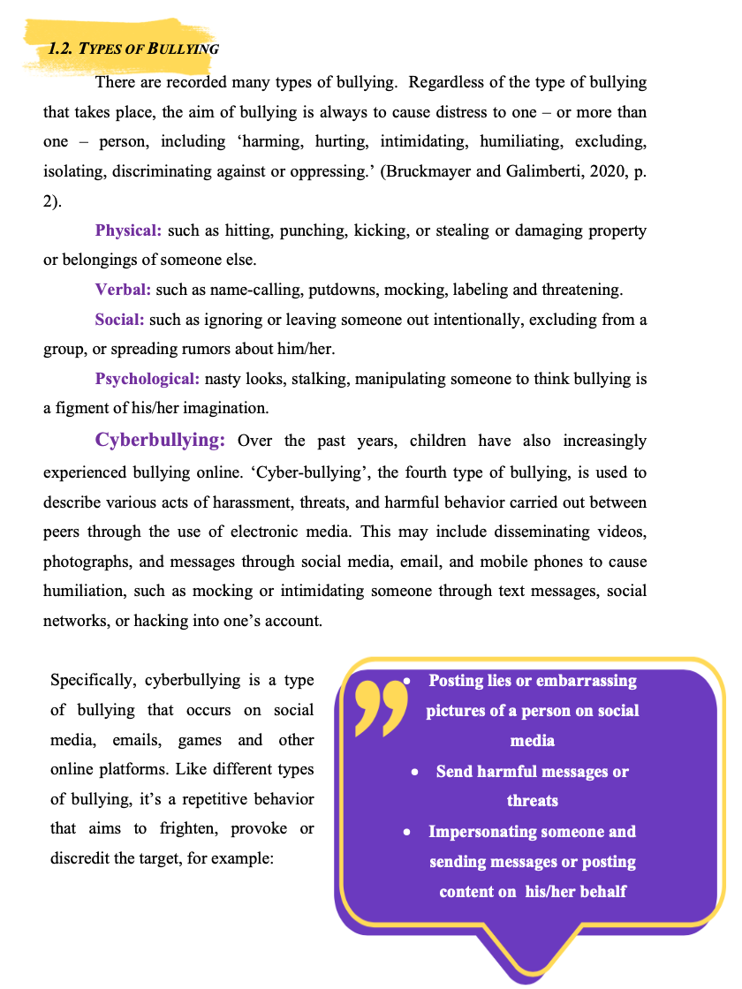
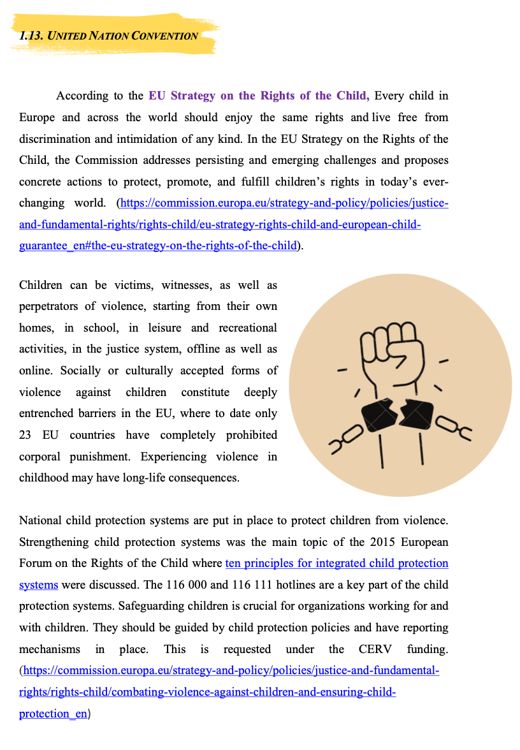
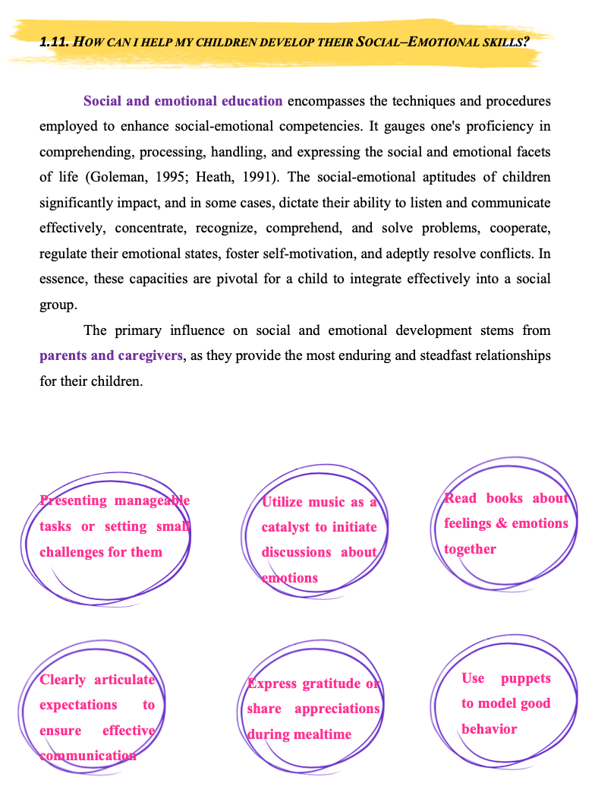
Chapter 1

Slide 10
Chapter 2
It is aimed at fostering positive environments and combating bullying, discrimination, and other social issues through various activities. These scenarios are designed to help students build social-emotional skills, combat bullying, and appreciate diversity.
The activities are:
Art-based educational scenarios that can be used to foster creativity and cultural appreciation
Addressing racism, and educating students about its roots and effects over time
Promoting problem-solving skills and teamwork
Focusing on healthy eating habits and how communal activities, can foster connections among students
Promoting friendship, unity, and respect

Slide 11
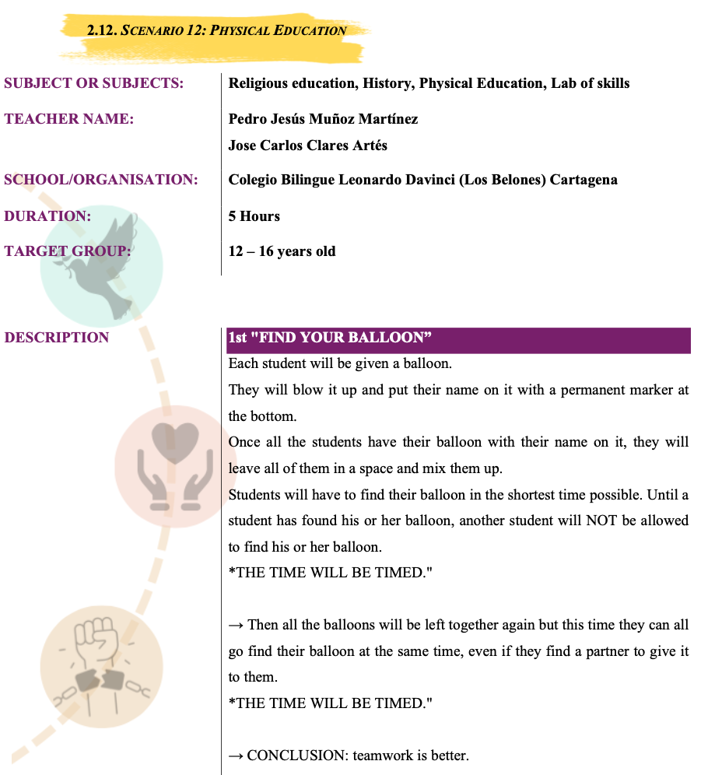
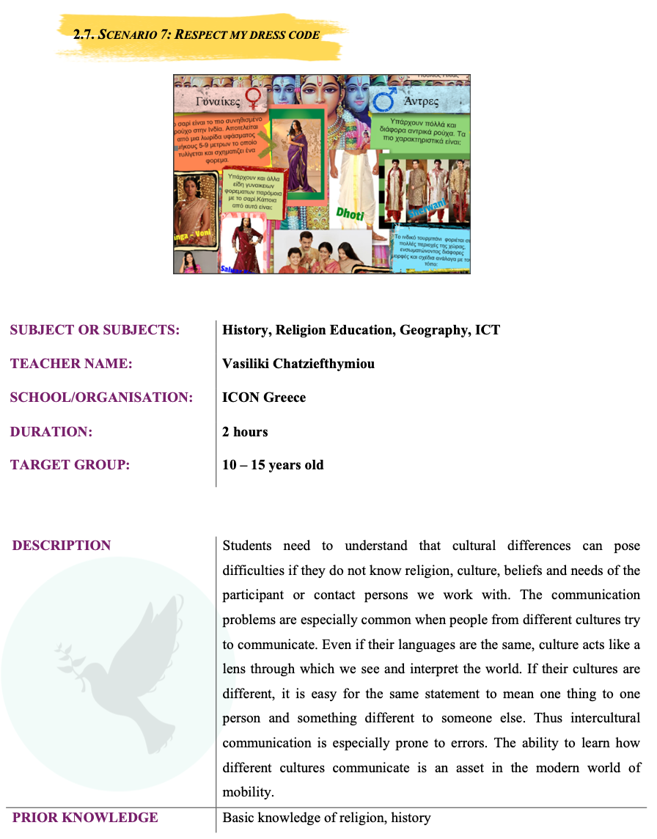
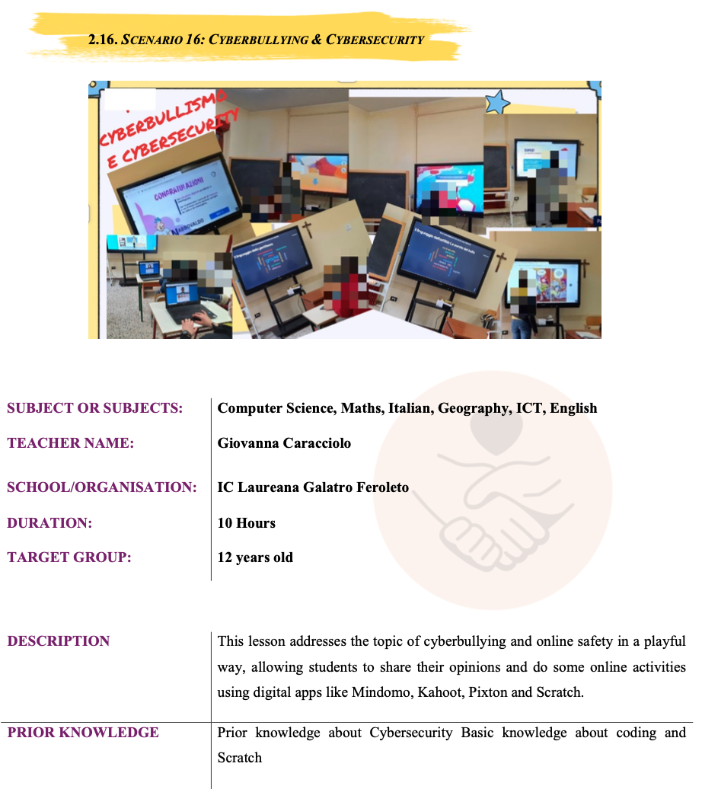
Chapter 2

Slide 12
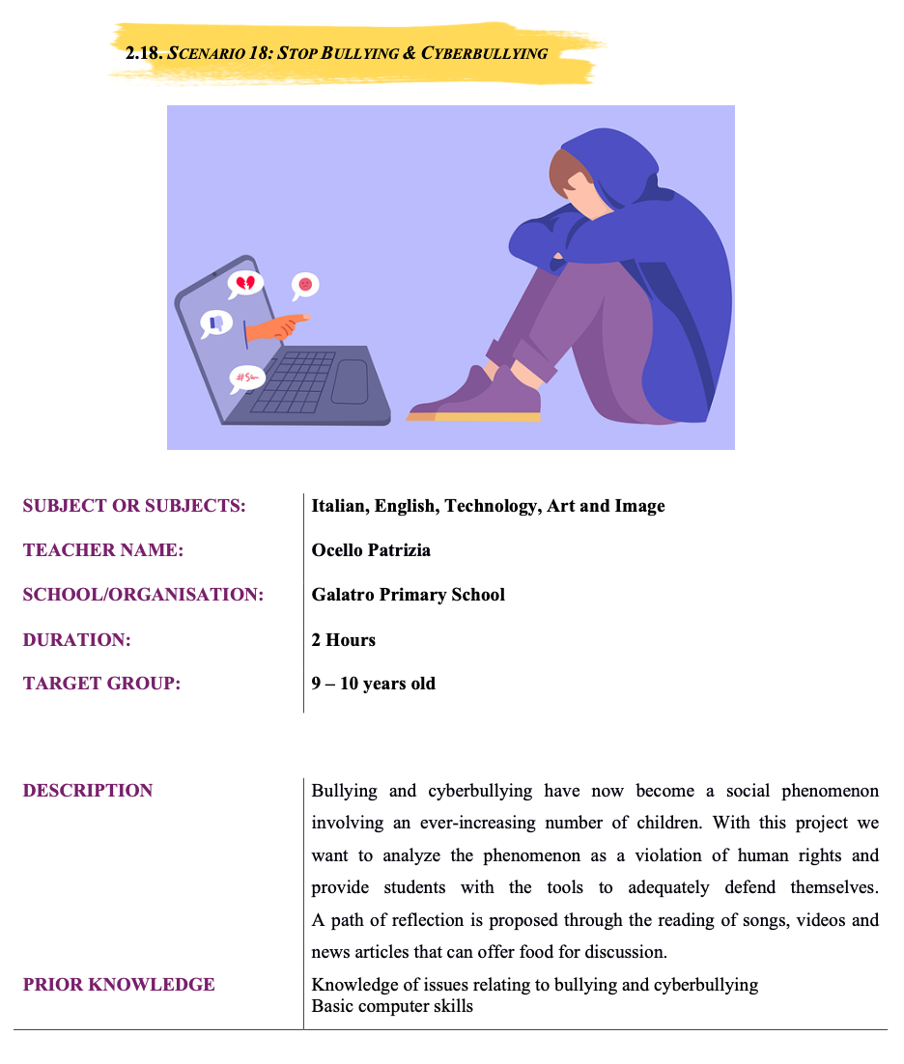
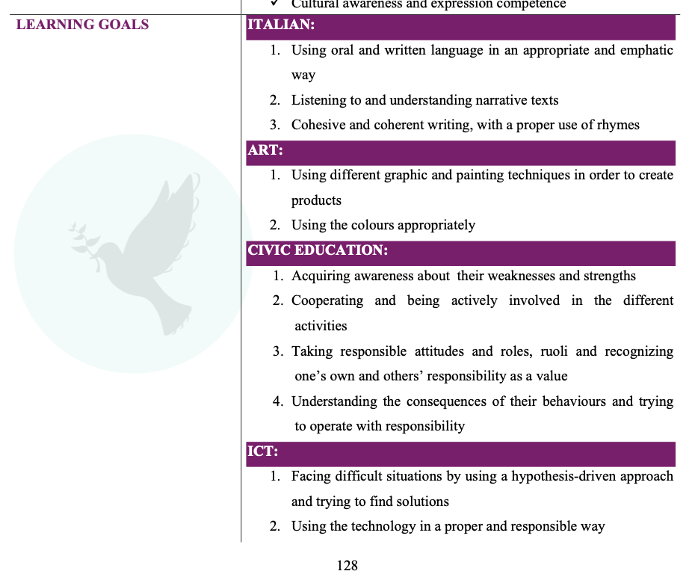
Chapter 2

Slide 13



Our Social Media:
Website
Facebook
Instagram
www.icongreece.gr
Icon Greece
icon.greece

Slide 14
THANKS FOR YOUR ATTENSION

